Slide 1
Do Additional Variables Improve the Accuracy of Total Population Forecasts Generated by Global Machine Learning
Group 12
Industry Partner: Dr Irina Grossman
Project Supervisor: Dr Kasun Bandara
Presented by: Chi Zhang, Haitong Gao, Yuexin Li, Eric Luanzon, Meijun Yue

Slide 2





Team Introduction
Chi Zhang
Eric Luanzon
Haitong Gao
Meijun Yue
Yuexin Li
Work Coordinating
Data Analysis
Data Preprocessing
Forecast Reconciliation
Data Visualisation
Data Visualisation
Meeting Agenda Arranging
Related Works Reading and Preliminary Models’ Investigation

Slide 3
Project Background
Uses of forecasting
Planning
Marketing
Distribution of funds
Problems with small-area forecasting:
Sparse data
Larger data requirements
Estimation of input data
Look into machine learning methods
->

Slide 4
Data Description
The Main Structure of the Australian Statistical Geography Standard
Australia
State and Territory
(S/T)
Statistical Area Level 4
(SA4)
Statistical Area Level 3
(SA3)
Statistical Area Level 2
(SA2)
Statistical Area Level 1
(SA1)
Mesh Block
(MB)

Slide 5
Data Description
Year | SA3 Name | Total
1991 | Goulburn - Yass | 61667
1991 | Queanbeyan | 35281
… | … | …
1992 | Goulburn - Yass | 61751
1992 | Queanbeyan | 36409
… | … | …
2011 | Goulburn - Yass | 69775
2011 | Queanbeyan | 56051
… | … | …
1991
-
2011

Slide 6
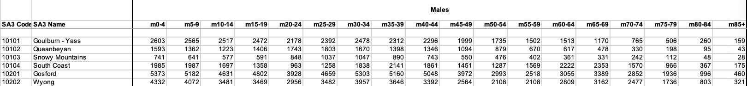
Data Description
Male & Female
0-4 | 5-9 | 10-14 | 15-19 | 20-24 | 25-29 | 30-34 | 35-39 | 40-44 | 45-49 | 50-54 | 55-59 | 60-64 | 65-69 | 70-74 | 75-79 | 80-84 | 85+
Each Region’s Time-series in one year: 2 * 18 (Sex Cohort * Age Cohort)
Partial Dataframe (Male Group)

Slide 7
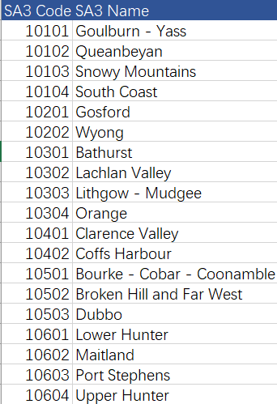
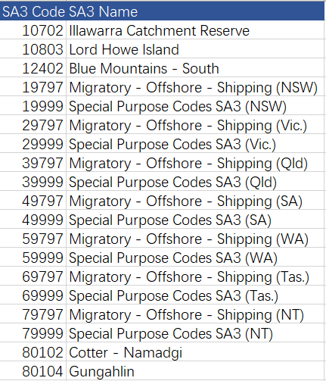
Preprocessing
Above 1000
Below 1000

Slide 8
Current Findings
Data Analysis – Data Sparsity & Population Growth Trend
Related Research
Potential Methods – Forecast Reconciliation & Theta / ETS Model
Preliminary Model – LSTM

Slide 9
Data Analysis – Descriptive Statistic
Maximum and Minimum of each cohort’s population is less informative
Anchoring Year 2000 total population value across all age-sex cohort in all regions

Slide 10
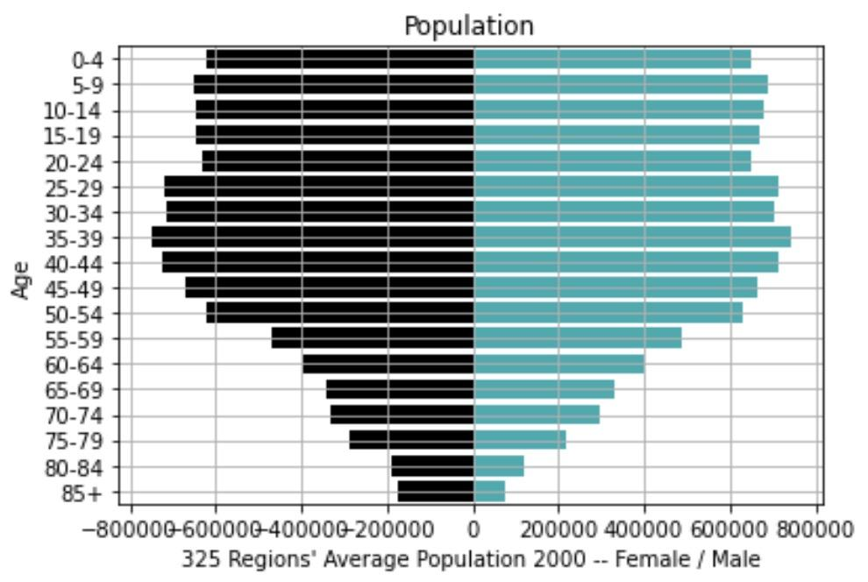
Data Analysis – Data Sparsity
Elder Age-Sex Cohorts Population’s Lacking

Slide 11
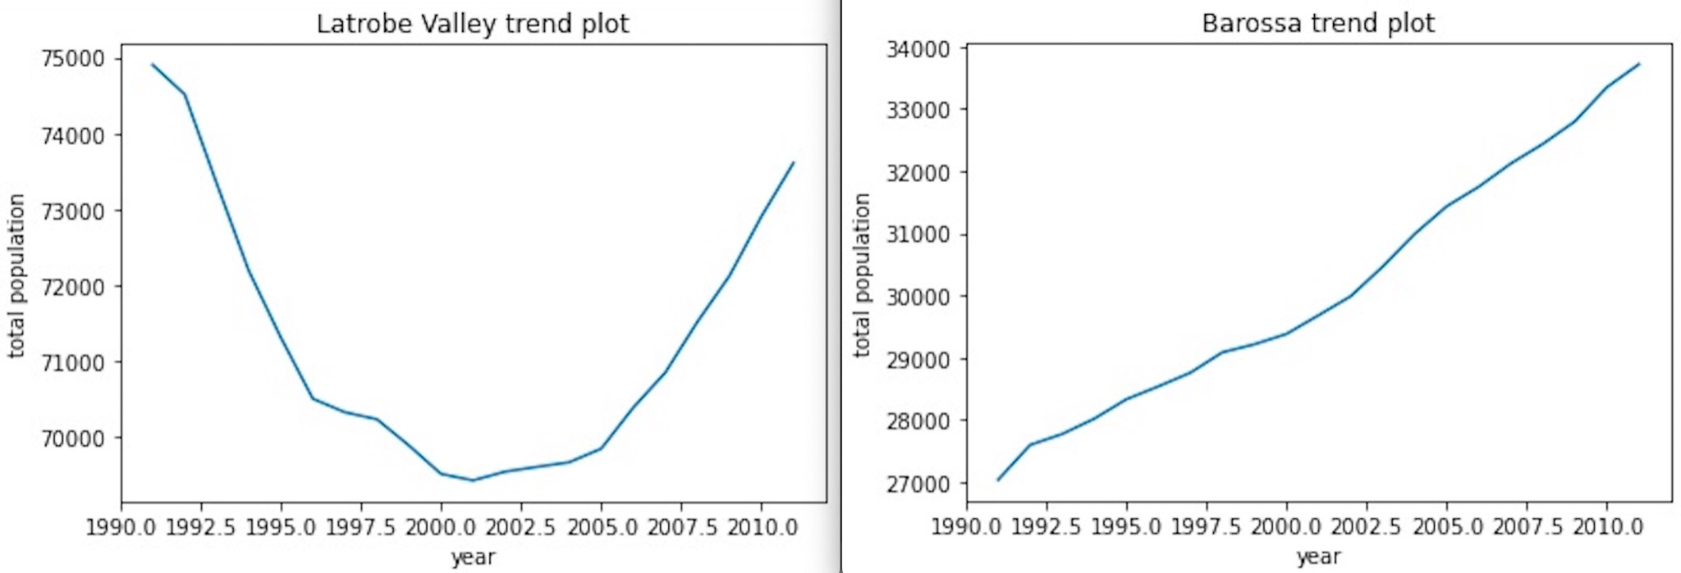
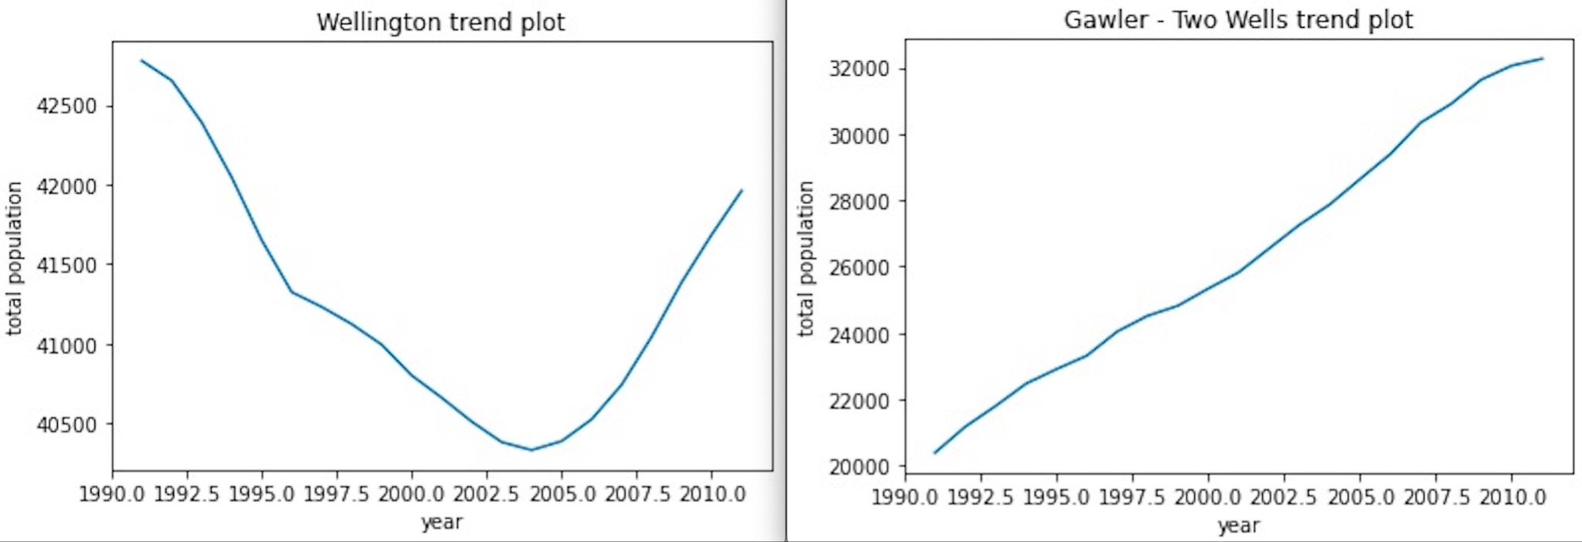
Data Analysis – Population Trends & Clustering
Data Trends – Region’s Population Growth Trends’ Difference / Similarity
Latrobe Valley vs. Barossa
Wellington vs. Gawler Two Wells

Slide 12
Related Research
Hamilton-Perry model:
Could be implemented without migration data, easy to implement
But less details output
Synthetic migration cohort-component model:
Contained the impact of the total population of the area
But changing the inward migration flows to maintain consistency
Decided to implement hierarchy models

Slide 13
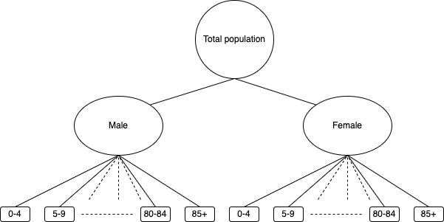
Forecast Reconciliation Method

Slide 14
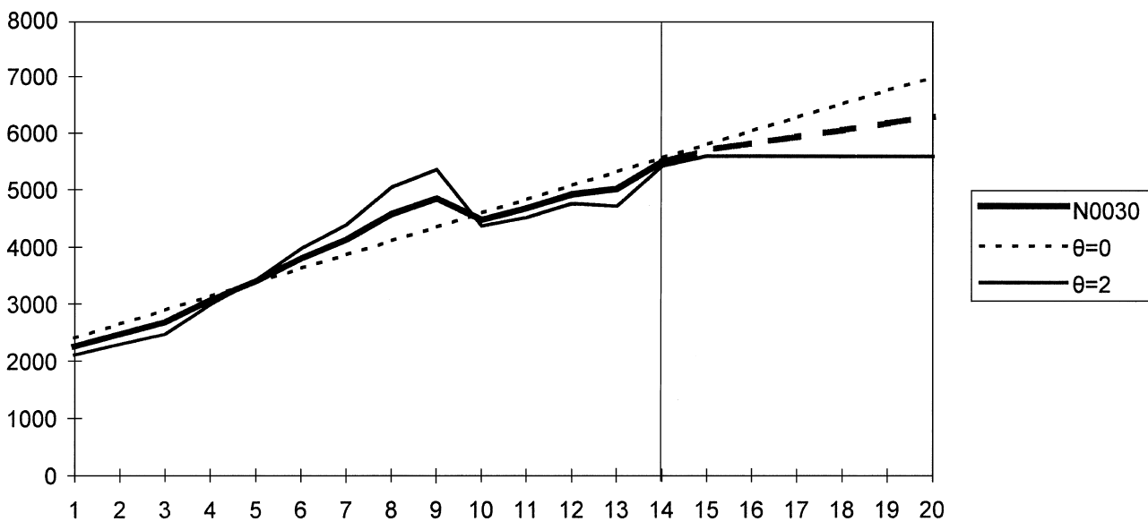
Potential Methods
Trend | Seasonal | Method
N | N | Simple exponential smoothing
A | N | Holt’s linear method
A | N | Additive Holt-Winters’ method
A | M | Multiplicative Holt-Winters’ method
Ad | A | Additive damped trend method
Ad | M | Holt-Winters’ damped method
Assimakopoulos, V. & Nikolopoulos, K., 2000. The theta model: a decomposition approach to forecasting. International Journal of Forecasting, 16(4), ppa. 521-530.
Fioruci, J. A., Pellegrini, T. R., Louzada, F. & Petropoulos, F., 2015. The Optimised Theta Method.
Hyndman, R.J., & Athanasopoulos, G. (2021) Forecasting: principles and practice, 3rd edition, OTexts: Melbourne, Australia. OTexts.com/fpp3. Accessed on 30 April 2022.

Slide 15
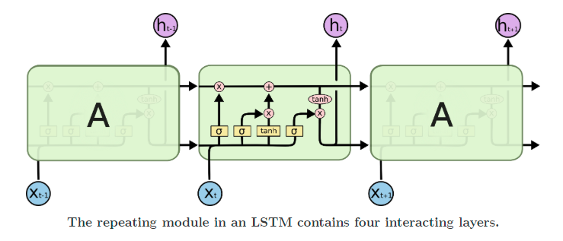
Long-Short Term Memory (LSTM)
Age & Sex Prediction
Three Steps for modelling:
Normalise input data
Decide time step
Unidirectional & Bidirectional
Motivations for this project:
SA3s Data
Time Range: 21 years
Multivariate Input: age & sex
New attributes if possible
https://blog.paperspace.com/time-series-forecasting-regression-and-lstm/

Slide 16

Evaluation
Fit on each:
1991 - 1996
1996 - 2001
2001 - 2006
2006 - 2011
Test:
2016
OR
2021
Notes:
5-10 Years Training set
5 Years Test set
New Data From ABS (2021)
New Model’s performance compares with benchmark

Slide 17
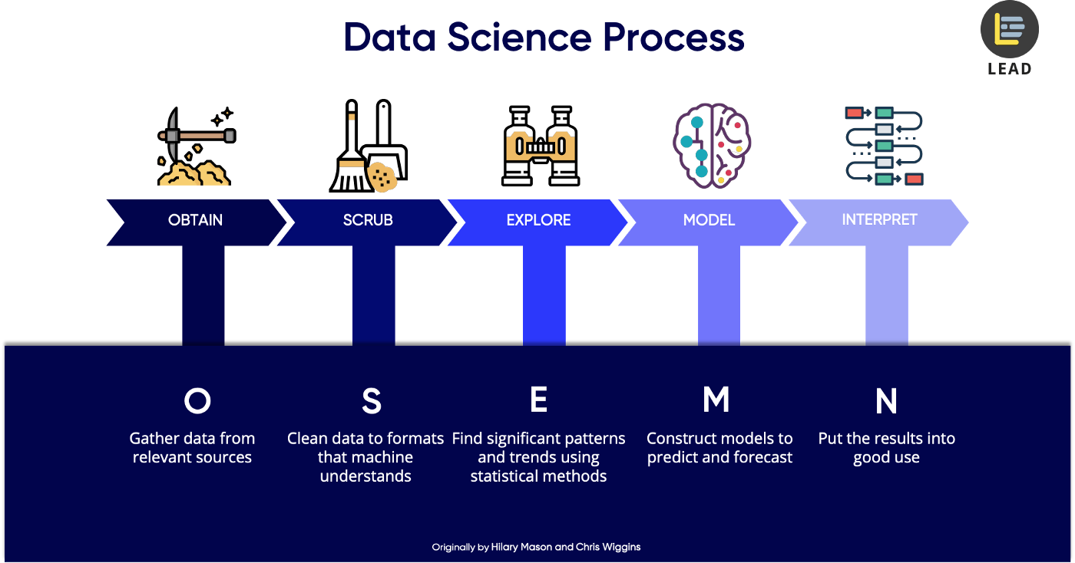
Next Semester Plans
Data Science Process (the O.S.E.M.N. framework)
https://towardsdatascience.com/5-steps-of-a-data-science-project-lifecycle-26c50372b492

Slide 18
Timeline
Task | Start Date | End Date | People Allocation | Additional Notes
Review (End 29/7)
Feedback for Sem 1 | Week 1 | Week 2 | all | Discuss the feedback given from the clients and supervisor.
New Findings | Week 1 | Week 2 | Haitong Gao, Chi Zhang | Report any findings during winter break.
Model Development (End 23/9)
Benchmark Model | Week 1 | Week 12 | all | Use benchmark model from client.
Model Building | Week 1 | Week 4 | Eric Luanzon, Yuexin Li, Meijun Yue | Population forecast in AUS.
Model Tuning | Week 4 | Week 6 | Same as above
Model Evaluation | Week 6 | Week 7 | Chi Zhang, Eric Luanzon, Meijun Yue
Model Interpretation | Week 6 | Week 8 | all | Result discussion, finalise code and tidyup.
Model Extension (End 7/10)
External Variables | Week 8 | Week 10 | Haitong Gao, Yuexin Li | Improve the model and make it more universal.
Report (End 21/10)
Draft Report | Week 6 | Week 11 | all
Final Report | Week 11 | Week 12 | all

Slide 19
Thank you!

Slide 20
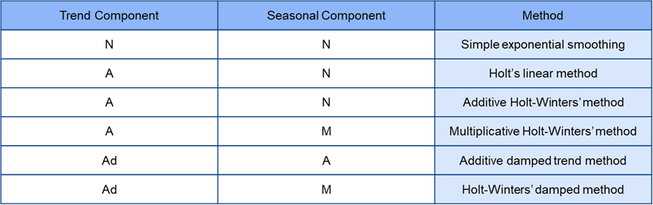
Exponential Smoothing (ETS)
Classification of ETS:
Model Selection:
R code:
model <- ETS( data )

Slide 21
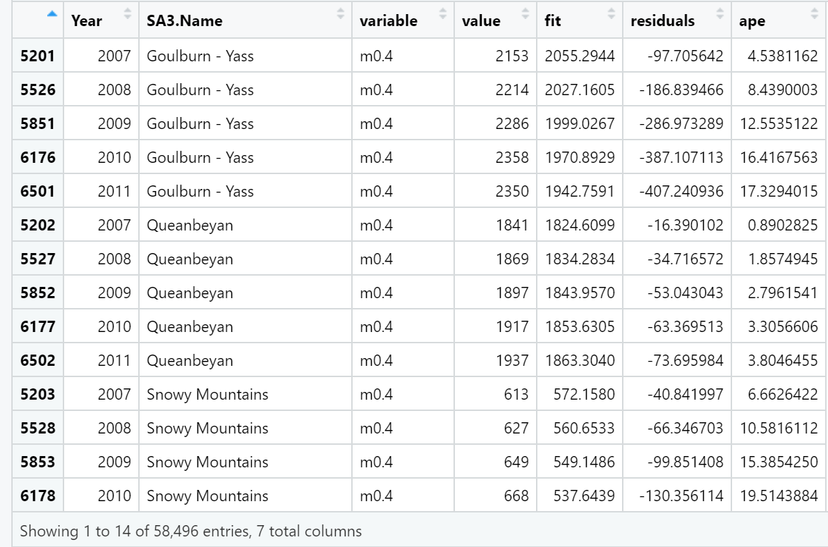
Theta
Assimakopoulos, V. & Nikolopoulos, K., 2000. The theta model: a decomposition approach to forecasting. International Journal of Forecasting, 16(4), pp. 521-530.
Fioruci, J. A., Pellegrini, T. R., Louzada, F. & Petropoulos, F., 2015. The Optimised Theta Method.

